Slide 1
Effective PowerPoint Presentations
Kimtoya Williams
Senior Presentation Specialist
April 20, 2017
Episcopal Communicators Conference
Notes:
Hello everyone – thank you very much for joining us today.
My name is Kimtoya Williams, I am the senior presentation specialist working in the communications department of The Church Pension Group. For those not familiar with the Church Pension Group, in addition to being a sponsor of this conference, we service the financial and insurance needs of Episcopal churches, clergy, and lay employees, as well as host numerous education and wellness conferences.
My goal today is to discuss a few best practices that will have you craft an effective and hopefully not boring presentation.

Slide 2
Agenda
Effective Content Building
Effective Slide Creation
Effective Formatting and Design
Effective Presentation
Questions and Answers
Notes:
Specifically, we will discuss how to build your presentation – that is how to develop your content so that you message is clear, concise and effective.
Then we will review creating an effective slide – what should and should not be on the slide
Next, we’ll discuss ways to add pizazz to your presentation with formatting and design tips
Then we’ll review best practices for how to present the dynamic presentation that you’ve built
Finally, we’ll open the floor for questions and answers

Slide 3
Meet Jim
Powerful Presentations: Simply Stated: How to Give an Awesome (PowerPoint Presentation (Whiteboard Animation Explanation Video), by Wienot Films, May 9, 2011.
Notes:
Before we get started I want to introduce you to Jim, Jim needed help with PowerPoint presentations, and found a solution that works effectively for him.

Slide 4
What was the most important lesson Jim learned?
The more words on a slide, the better.
Prepare and practice is best.
Use as many charts as possible.

Slide 5
What was the most important lesson Jim learned?
The more words on a slide, the better.
Prepare and practice is best.
Use as many charts as possible.

Slide 6
Building Your Presentation
Notes:
OK – so let’s build your presentation

Slide 7
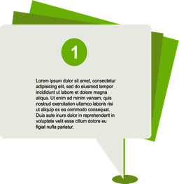
Outline and Script
Climax!
Outline to structure thoughts into concise message
Write a script to help you stay on message
End
Middle
Beginning
Create a story with beginning, middle, and end
Build to a climax or final take-away message
Notes:
The first step to build your presentation to is to prepare an outline and script
Write an Outline – just like when we first learned how to write a great school report or essay. You need an outline to bullet point what you want to discuss and what information you want to provide. Starting with an outline will build a solid framework for your presentation deck and will help you to stay on message from slide to slide
Write a script – Because you don’t want a slide to give your audience reading material – the script will relay what you are going to say, while the slide visualizes it.
A good script should tell a story and have a beginning, middle, and end that
builds to a climax or final take-away message for your audience.
http://www.lifehack.org/articles/featured/10-tips-for-more-effective-powerpoint-presentations.html

Slide 8
Creating an Effective Slide
Notes:
People tend to tune in and out every 15-20 mins or so . This means, in any given moment, only about 25% of your audience are fully attentive!
Your PPT slideshow is just another medium to communicate information – a visual medium. You should ask yourself, how does this complement the other ways that I’m communicating my message? If I have a bunch of text on a slide, how is that different from your audience reading a textbook?
So, for our slideshows (and for our individual slides) we need to ask ourselves, how will this help me reach and hold those other 75% of my audience?
How do we create an effective slide

Slide 9
Keep it Simple
Follow the industry-recommended “6x6” rule:
Six words per line
Six lines per slide
Use bullet points, phrases, and single words
Do not fill the slides with text
Keep text concise and slide number to a minimum
Notes:
There is only so much the audience can look at and listen to at the same time. If you’re overloading your slides, you’re overloading the audience – so keep it simple
Follow the industry-recommended "6x6" rule: This rule says a perfect slide will have Six words per line, and if possible, no more than six lines per slide.
Use bullet points, phrases, quotes, and/or single words. Avoid full sentences. Do not fill the slides with text.

Slide 10
One Thing at a Time
Talk about what’s on the screen
Strategically reveal bullet points and visuals
Notes:
At any given moment, what should be on the screen is the thing you’re talking about. Our audience will almost instantly read every slide as soon as it’s displayed; if you have the next four points you plan to make up there, they’ll be three steps ahead of you, waiting for you to catch up rather than listening with interest to the point you’re making.
[CLICK]
Plan your presentation so just one new point is displayed at any given moment.
[CLICK]Bullet points can be revealed one at a time as you reach them.
[CLICK]Visuals can be included to drive home your main message for the slide.
Your job as presenter is to control the flow of information so that you and your audience stay in sync.

Slide 11
This Is Not a Document
Notes:
A common mistake made by presenters, is they treat the presentation like a stand-alone document
They put everything they want to say on the slide – so what you see are big chucky blocks of text. – So please don’t do that
Do that and Congratulations -- You’ve just killed a roomful of people. Cause of death: terminal boredom poisoning.

Slide 12
This Is Not a Document
Your slide is the
for your presentation,
illustration
not
the presentation itself.
Notes:
Your slides are the illustrations for your presentation,
not the presentation itself. They should underline and reinforce what you’re saying as you give your presentation — save the paragraphs of text for your script and put them into your speaker notes.

Slide 13
Even if Reading from the Screen, Don’t Stand with Your Back to Your Audience!
Notes:
IF for some reason you do put paragraphs on the screen, please don’t stand with your back to your audience and read it from the screen!

Slide 14
Formatting and Designing Your Presentation
Notes:
So now that you’ve done your prep work. You’ve made an outline and scripted your presentation. You’ve learned what it takes to build an effective slide. You are now ready to actually format and design your presentation

Slide 15
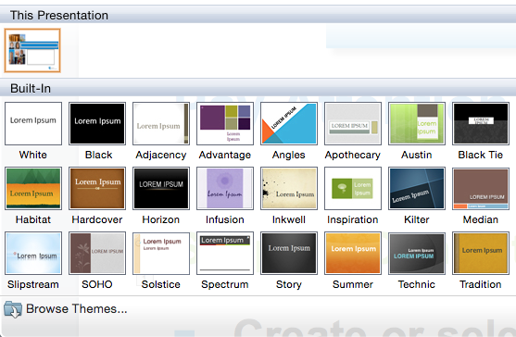
Formatting Essentials
Simple + Consistent = Professional
Create or select a template and style for your slides
Build master slides to create a template, OR
Select an already created PowerPoint template from their Theme Library
Notes:
Formatting refers to how your presentation will look – the fonts, the colors, the position of slide titles, bulleted texts, images, etc.
Simple and most importantly a consistent and uniform look from slide to slide is what will produce a professional looking presentation
Start by creating or selecting a template or style for your slides. Depending upon your comfort level with PowerPoint – you can build master slides to create a template.
OR select an already created PowerPoint template from their Theme Library. The template will give you slide layouts to use for different types of slides: title slide, text slides, divider slides, and more
than that and you risk losing your audience as they sort it all out.

Slide 16
Formatting Essentials
Simple + Consistent = Professional
Use a sans serif font for body text
Avoid decorative fonts
San Serif is easier to read
Decorative fonts are harder to read
Notes:
Use a sans serif font for body text. Sans serifs like Arial, Helvetica, or Calibri tend to be the easiest to read on screens.

Slide 17
Formatting Essentials
Simple + Consistent = Professional
Dark text on light background and vice versa
Dark text on light background
Light text on dark background
Notes:
Put dark text on a light background. Again, this is easiest to read. If you must use a dark background –make sure your text is quite light (white, cream, light grey, or pastels) and maybe bump the font size up two or three notches.

Slide 18
Formatting Essentials
Simple + Consistent = Professional
Align text left or right — avoid centered text
Avoid clutter
Left aligned or right aligned text looks more professional
Centered text looks less professional
on slides
Notes:
Align text left or right. Centered text is harder to read and looks amateurish. Line up all your text to a right-hand or left-hand baseline – it will look better and be easier to follow.
Avoid clutter. A headline, a few bullet points, maybe an image – anything more than that and you risk losing your audience as they sort it all out.

Slide 19
Outsource It! If Possible, Hire a Graphic Designer

Slide 20
Approximate Cost for Basic Template is $200 – $500
Expect at least a Title and Interior Slide

Slide 21
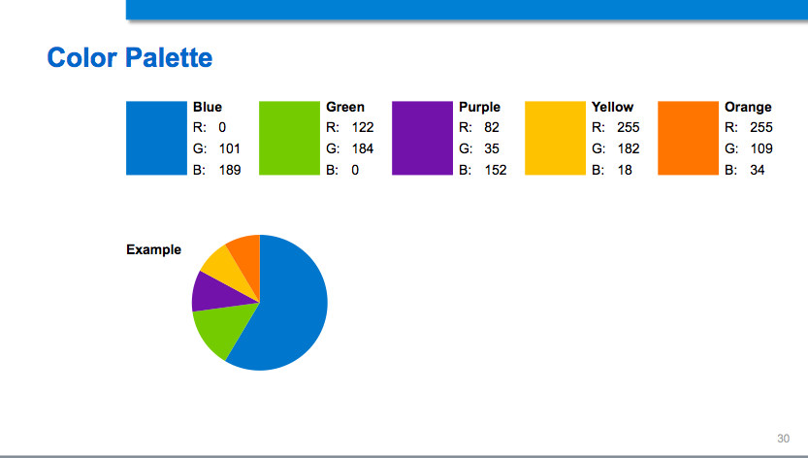
A Complete Template will Include a Color Palette that Compliments Your Logo

Slide 22
Pay Attention to Design…
Simple
+
Consistent
= Professional
Notes:
Because PPT offers a lot of ways to add visual “flash” to a slide – does not mean you should use all of them. Fades, swipes, flashing text, etc. can be annoying to the viewer. Instead, focus on concise slides that are consistent from beginning to end. This gives your presentation a more professional look

Slide 23
…Not Distracting PPT Animations
Simple
+
Consistent
= Professional
Notes:
Because PPT offers a lot of ways to add visual “flash” to a slide – does not mean you should use all of them. Fades, swipes, flashing text, etc. can be annoying to the viewer. Instead, focus on concise slides that are consistent from beginning to end. This gives your presentation a more professional look

Slide 24
Dos and Don’ts

Slide 25
Don’t Overcrowd a Slide with Too Much Information
Compared to male priests, fewer female priests have full-time work at a single employer and more female priests have part-time work
 | Female Priests | Male Priests
Full-time TEC Single Employer | 50% | 66%
Full-time TEC Multiple Employers | 6% | 5%
Part-time TEC Single Employer | 15% | 6%
Bivocational (TEC & Non-TEC Work) | 11% | 11%
Supply Work | 2% | <1%
Interims | 4% | 3%
Non-stipendiary/Non-cash Comp | 2% | 1%
Non-TEC Work Only | 7% | 7%
No Work | 3% | 1%
Notes:
This slide is a perfect example of overcrowding.
Your audience does not know where to look – they don’t know what is the most important message on this slide

Slide 26
This is What The Client Wants to Highlight
Compared to male priests, fewer female priests have full-time work at a single employer and more female priests have part-time work
 | Female Priests | Male Priests
Full-time TEC Single Employer | 50% | 66%
Full-time TEC Multiple Employers | 6% | 5%
Part-time TEC Single Employer | 15% | 6%
Bivocational (TEC & Non-TEC Work) | 11% | 11%
Supply Work | 2% | <1%
Interims | 4% | 3%
Non-stipendiary/Non-cash Comp | 2% | 1%
Non-TEC Work Only | 7% | 7%
No Work | 3% | 1%
Notes:
What the presenter wants to highlight [CLICK] is the fact that there are fewer full time employed female priests than male priests --- but that message gets lost

Slide 27
Find a Way to Highlight Your Main Take-Away
Compared to male priests
Fewer female priests have full-time work at a single employer
Notes:
Instead – find a way to highlight your main take away
CLICK
CLICK

Slide 28
Don’t Have Text…
Full-time employment with a long-term position title at one parish
Percent of Active-age Sample: 52%*
Gender:
62% male
38% female
Average Age: 53
Average Credited Service: 15
Average Compensation: $86,400
*This is less than the 58% you see on slide 10 because of the added layer of working parochially only.

Slide 29
…After Text…
Employment from a non-parochial Episcopal institution only
Percent of Active-age Sample: 6%
Gender:
51% male
49% female
Average Age: 54
Average Credited Service: 14
Average Compensation: $89,400
The majority of non-parochial work is for dioceses or schools

Slide 30
…After Text Slides…Boring!
Paid Employment from multiple TEC employers
Percent of Active-age Sample: 5%
Gender:
52% male
48% female
Average Age: 54
Average Credited Service: 12
Average Compensation: $64,900

Slide 31
Instead, Find a Way to Visualize with an Infographic
Active
Retired
All Priests
Had break in FT service
23%
20%
23%
Avg. number
of breaks
1.6
1.9
1.7
Avg. break
length (months)
16
15
16

Slide 32
Mission
BEFORE
Achieve and balance two competing objectives:
Serve the Church- provide very broad insurance coverage; cost effective risk management programs; and competitive pricing.
Financial Viability- consistently achieve financial results sufficient to fund the company and all future growth.

Slide 33
We Must Keep Balance
AFTER
Meeting Client Needs
Financial Stewardship

Slide 34
Use Images Wisely
Avoid Microsoft’s built-in clip art gallery
Use quality illustrations, photographs, or clip art
Dated and
Cliché
Current and
Professional
Notes:
There are two schools of thought about images in presentations. Some say they add visual interest and keep audiences engaged; others say images are an unnecessary distraction.
Both arguments have some merit, so I always lean towards using images IF they:
add important information
Make an abstract point more concrete
Drive home your message [CLICK[
Avoid Microsoft’s built-in clip art gallery: anything in those galleries has been seen by everyone in your audience thousands of times
[CLICK]– they tend to look dated and cliché
Use quality illustrations, photographs, or clip art – which will achieve a more
[CLICK] polished and professional look

Slide 35
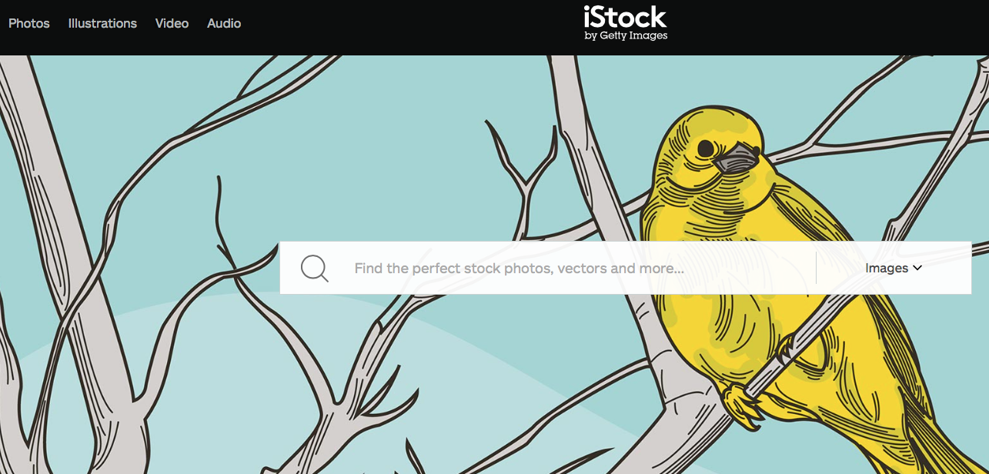
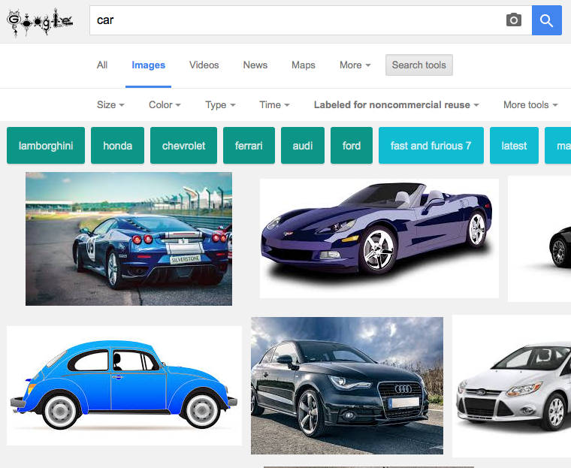
Online Image Sources
Use royalty-free photo providers:
iStock
Shutterstock
123rf
Use internet search engines, BUT, filter for “non-commercial” use if appropriate, OR
Only use images that provide license to use instructions
Notes:
Don’t worry, if you’re not an artist with amazing drawing skills, there are on-line options available to you…
- Use royalty-free photo providers, e.g., iStock – open an account and purchase images as you need them. There are usually images available to suit every budget
Use can also internet search engines to find noncommercial use images – these are images that the owner gives licensed permission for you to use for non-commercial and/or educational purposes only. Usually they are quite specific on how to use, if you can modify the image, and how they want citation or acknowledgement of their ownership to appear in your presentation. I’ll give a brief demonstration on how to find such an image…
The search tools I most often use are:
1. Size – the larger the image size, the more clarity the image will have, and
2. Usage rights – the usage rights indicate how the image was labeled for use by the owner:

Slide 36
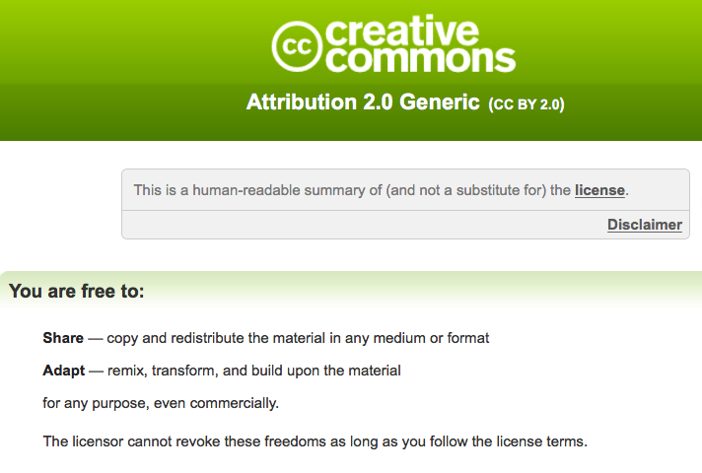
Corporate Logo Found Using Google Search
Image found on Flickr using Google search
Photographer and license info provided
License provides instruction on how to acknowledge and cite author’s image
1
3
2
3
Photo: VW Badge: by Gerry Lauzon, December 6, 2011, License CC By 2.0
Notes:
A lot of times you want to use a company logo to make your point – but most companies have a rigorous review process before they’ll grant permission for you to use their copyrighted logo and/or trademark images. This process can take a lot of times, and permission is not always granted.
So finding photographs taken in the public domain that the owner gives licensed permission to use is a great alternative.
In this example we found a photo of a car that displays the Volkswagen logo. The photographers gives permission for use – as long as he is credited as you see on the slide.

Slide 37
Presenting Your Presentation
Notes:
Now that you’ve built a dynamic presentation --- you don’t want to ruin it by presenting it in a less than dynamic way. So here are a few tips

Slide 38
Presenting Yourself
Look at the audience
Notes:
Now that you’ve built a dynamic presentation --- you don’t want to ruin it by presenting it any way but fabulously. So here are a few tips
Look at the audience – If you ever wondered where you should be looking when presenting, the answer is right in front of you. Don’t just single out one person, but instead try to make eye contact with numerous people throughout the room. If you don’t do this then you aren’t engaging the audience, you are just talking to yourself. This can result in an utter lack of attention from your audience.
CLICK]Instead Talk to your audience, not at them – People hate it when they get talked at. You need to interact with your audience and create a conversation.
CLICK An easy way to do this is to ask them questions as well as letting them ask you questions. Show your personality – It doesn’t matter if you are presenting to a corporate crowd or to senior citizens, you need to show some character when presenting. Modulate and make sure you don’t sound bored or like a robot
[CLICK]Make them laugh – Although you want to educate your audience, you need to make them laugh as well. it keeps the audience alert and they’ll learn more from you than someone who just educates. Think of your favorite teachers growing up– the ones whose class you didn’t mind so much – they probably interjected their lesson plans with humor. It works!
[CLICK]Show some movement – You probably know that you need to show some movement when speaking, but naturally you may forget to do so. Make sure you show some gestures or pace around a bit (not too much) on the stage when speaking. Remember, no one likes watching a stiff. People are more engaged with an animated speaker.

Slide 39
Presenting Yourself
Talk to your audience, not at them
Notes:
Now that you’ve built a dynamic presentation --- you don’t want to ruin it by presenting it any way but fabulously. So here are a few tips
Look at the audience – If you ever wondered where you should be looking when presenting, the answer is right in front of you. Don’t just single out one person, but instead try to make eye contact with numerous people throughout the room. If you don’t do this then you aren’t engaging the audience, you are just talking to yourself. This can result in an utter lack of attention from your audience.
CLICK]Instead Talk to your audience, not at them – People hate it when they get talked at. You need to interact with your audience and create a conversation.
CLICK An easy way to do this is to ask them questions as well as letting them ask you questions. Show your personality – It doesn’t matter if you are presenting to a corporate crowd or to senior citizens, you need to show some character when presenting. Modulate and make sure you don’t sound bored or like a robot
[CLICK]Make them laugh – Although you want to educate your audience, you need to make them laugh as well. it keeps the audience alert and they’ll learn more from you than someone who just educates. Think of your favorite teachers growing up– the ones whose class you didn’t mind so much – they probably interjected their lesson plans with humor. It works!
[CLICK]Show some movement – You probably know that you need to show some movement when speaking, but naturally you may forget to do so. Make sure you show some gestures or pace around a bit (not too much) on the stage when speaking. Remember, no one likes watching a stiff. People are more engaged with an animated speaker.

Slide 40
Presenting Yourself
Ask questions
Notes:
Now that you’ve built a dynamic presentation --- you don’t want to ruin it by presenting it any way but fabulously. So here are a few tips
Look at the audience – If you ever wondered where you should be looking when presenting, the answer is right in front of you. Don’t just single out one person, but instead try to make eye contact with numerous people throughout the room. If you don’t do this then you aren’t engaging the audience, you are just talking to yourself. This can result in an utter lack of attention from your audience.
CLICK]Instead Talk to your audience, not at them – People hate it when they get talked at. You need to interact with your audience and create a conversation.
CLICK An easy way to do this is to ask them questions as well as letting them ask you questions. Show your personality – It doesn’t matter if you are presenting to a corporate crowd or to senior citizens, you need to show some character when presenting. Modulate and make sure you don’t sound bored or like a robot
[CLICK]Make them laugh – Although you want to educate your audience, you need to make them laugh as well. it keeps the audience alert and they’ll learn more from you than someone who just educates. Think of your favorite teachers growing up– the ones whose class you didn’t mind so much – they probably interjected their lesson plans with humor. It works!
[CLICK]Show some movement – You probably know that you need to show some movement when speaking, but naturally you may forget to do so. Make sure you show some gestures or pace around a bit (not too much) on the stage when speaking. Remember, no one likes watching a stiff. People are more engaged with an animated speaker.

Slide 41
Presenting Yourself
Show your personality
Make them laugh
Notes:
Now that you’ve built a dynamic presentation --- you don’t want to ruin it by presenting it any way but fabulously. So here are a few tips
Look at the audience – If you ever wondered where you should be looking when presenting, the answer is right in front of you. Don’t just single out one person, but instead try to make eye contact with numerous people throughout the room. If you don’t do this then you aren’t engaging the audience, you are just talking to yourself. This can result in an utter lack of attention from your audience.
CLICK]Instead Talk to your audience, not at them – People hate it when they get talked at. You need to interact with your audience and create a conversation.
CLICK An easy way to do this is to ask them questions as well as letting them ask you questions. Show your personality – It doesn’t matter if you are presenting to a corporate crowd or to senior citizens, you need to show some character when presenting. Modulate and make sure you don’t sound bored or like a robot
[CLICK]Make them laugh – Although you want to educate your audience, you need to make them laugh as well. it keeps the audience alert and they’ll learn more from you than someone who just educates. Think of your favorite teachers growing up– the ones whose class you didn’t mind so much – they probably interjected their lesson plans with humor. It works!
[CLICK]Show some movement – You probably know that you need to show some movement when speaking, but naturally you may forget to do so. Make sure you show some gestures or pace around a bit (not too much) on the stage when speaking. Remember, no one likes watching a stiff. People are more engaged with an animated speaker.

Slide 42
Presenting Yourself
Move!
Notes:
Now that you’ve built a dynamic presentation --- you don’t want to ruin it by presenting it any way but fabulously. So here are a few tips
Look at the audience – If you ever wondered where you should be looking when presenting, the answer is right in front of you. Don’t just single out one person, but instead try to make eye contact with numerous people throughout the room. If you don’t do this then you aren’t engaging the audience, you are just talking to yourself. This can result in an utter lack of attention from your audience.
CLICK]Instead Talk to your audience, not at them – People hate it when they get talked at. You need to interact with your audience and create a conversation.
CLICK An easy way to do this is to ask them questions as well as letting them ask you questions. Show your personality – It doesn’t matter if you are presenting to a corporate crowd or to senior citizens, you need to show some character when presenting. Modulate and make sure you don’t sound bored or like a robot
[CLICK]Make them laugh – Although you want to educate your audience, you need to make them laugh as well. it keeps the audience alert and they’ll learn more from you than someone who just educates. Think of your favorite teachers growing up– the ones whose class you didn’t mind so much – they probably interjected their lesson plans with humor. It works!
[CLICK]Show some movement – You probably know that you need to show some movement when speaking, but naturally you may forget to do so. Make sure you show some gestures or pace around a bit (not too much) on the stage when speaking. Remember, no one likes watching a stiff. People are more engaged with an animated speaker.

Slide 43
To Do
Watch what you say
Think outside of the screen
KISS your audience:
Always express a take-home message
Break the rules!
Keep It Straight and Simple
Notes:
DO: Watch what you say – You usually don’t notice when you say “uhm”, “ah”, or any other useless word frequently, but the audience does. It gets quite irritating; so much that some members of the audience will probably count how many times you say these useless words.
DO: Think outside the screen; Remember, the slides on the screen are only part of the presentation – and not the main part. Give some thought to your own presentation manner – how you hold yourself, what you wear, how you move around the room. You are the focus when you’re presenting, no matter how interesting your slides are.
DO: KISS your audience
[CLICK] Keep it straight and Simple Remember that your slides are only there to support, not to replace your talk! You’ll want to tell a story, describe your data or explain circumstances, and only provide keywords through your slides. If you read your slides and if you do it slow and badly, the audience will get bored and stop listening.
DO: Take home message: Always express a Take Home Message: a summary of your data or story. Make it a highlight that stands out.
DO: Break the rules – like all things in life, there are times when each of these rules won’t apply. The better prepared you are, the more flexible you will be when you need to break a rule to keep your presentation moving forward and keep your audience engage.

Slide 44
Not To Do
Don’t overcrowd slides
Don’t read from the slides
Don’t freeze up
Don’t use cliché clip art
Don’t overthink it!
Notes:
Do not overcrowd slides – keywords only, avoid sentences
Do not read from the slide – never ready from your slides, talk freely
Don’t freeze up – the audience probably doesn’t know what they don’t know – so if you notice a mistake in your deck, somethings missing, or another mishap – just keep on going.
Don’t use cliché clip art – don’t bore your audience with seen before images. Find other ways to add pizazz to your deck: Font size and color, stock art images, non-commercial use images
Don’t overthink it! – 9 times out of 10, you are a subject matter expert about the topic of your presentation – so be confident you know your stuff. Go with the flow, be flexible and enjoy your presentation so your audience will too.

Slide 45
Do This…
Keep it brief and structured
Invite others to contribute
Use humor (not corny jokes, but honest and light hearted repartee)
Focus on the positive
Look well put together
Relax!
Notes:
1. Keep it brief – clean, clear, structured. Make an agenda and stick to it
2. Invite others to contribute – give them advanced notice you will call on them. Keeps people alert for their ‘moment in the sun’ and mix up voices
3. Use humor – not corny jokes, but honest & light-hearted
4. Relax – it’s not the Queen, loosen up and enjoy yourself. Don’t worry about mistakes move on
5. Focus on the positive -
6. Look decent

Slide 46
Don’t Do This…
Don’t wait till presentation to see venue and equipment
Don’t ignore your audience
Don’t do corporate speak (e.g., using acronyms without explaining)
Don’t expect high-fives and cheers: don’t pace the room like a football coach
Notes:
Don’t open with anecdote
Don’t be schoolmarm – not that there’s anything wrong with being a schoolmarm – just save that for the classroom – no need to call calling on students to define terms or provide examples
3. Don’t do corporate speak – avoid techno speak, acronyms, buzzwords
4. Don’t expect high-fives, cheers: don’t pace the room like a football coach

Slide 47
Resources
Istock.com – stock photography, illustrations, infographics (any budget)
Unsplash.com & Pexels.com – free stock photography
Tagul.com – free word clouds that you create
Google Search Engine – find images that provide license to use
Self photography – use your smart phone camera
Pictochart.com – infographics and easy-to-use templates
PowerPoint – library of templates
Freestockmusic.com – free music clips
Lynda.com – online tutorials for PowerPoint and other software

Slide 48
Questions?
Feel free to contact me with your PowerPoint questions
Kimtoya Williams Senior Presentation Specialist Church Pension Group Communications Department kwilliams@cpg.org 212-592-6291 www.cpg.org

